Slide 1
Introduction toBootstrap

Slide 2
What is Bootstrap?
Bootstrap is a free front-end framework for faster and easier web development
Bootstrap includes HTML and CSS based design templates for typography, forms, buttons, tables, navigation, modals, image carousels and many other, as well as optional JavaScript plugins
Bootstrap also gives you the ability to easily create responsive designs

Slide 3
What is Responsive Web Design?
Responsive web design is about creating web sites which automatically adjust themselves to look good on all devices, from small phones to large desktops.

Slide 4
Bootstrap is the world's most famous free CSS framework.
Bootstrap 5 is the newest version of Bootstrap, which is the most popular HTML, CSS, and JavaScript framework for creating responsive, mobile-first websites.

Slide 5
Why Use Bootstrap?
Easy to use: Anybody with just basic knowledge of HTML and CSS can start using Bootstrap
Responsive features: Bootstrap's responsive CSS adjusts to phones, tablets, and desktops
Mobile-first approach: In Bootstrap, mobile-first styles are part of the core framework
Browser compatibility: Bootstrap 5 is compatible with all modern browsers (Chrome, Firefox, Edge, Safari, and Opera). Note that if you need support for IE11 and down, you must use either BS4 or BS3.

Slide 6
Where to Get Bootstrap 5?
There are two ways to start using Bootstrap 5 on your own web site.
You can:
Include Bootstrap 5 from a CDN
Download Bootstrap 5 from getbootstrap.com

Slide 7
Bootstrap 5 CDN
If you don't want to download and host Bootstrap 5 yourself, you can include it from a CDN (Content Delivery Network).
jsDelivr provides CDN support for Bootstrap's CSS and JavaScript:

Slide 8
One advantage of using the Bootstrap 5 CDN: Many users already have downloaded Bootstrap 5 from jsDelivr when visiting another site. As a result, it will be loaded from cache when they visit your site, which leads to faster loading time. Also, most CDN's will make sure that once a user requests a file from it, it will be served from the server closest to them, which also leads to faster loading time. JavaScript? Bootstrap 5 use JavaScript for different components (like modals, tooltips, popovers etc). However, if you just use the CSS part of Bootstrap, you don't need them.

Slide 9
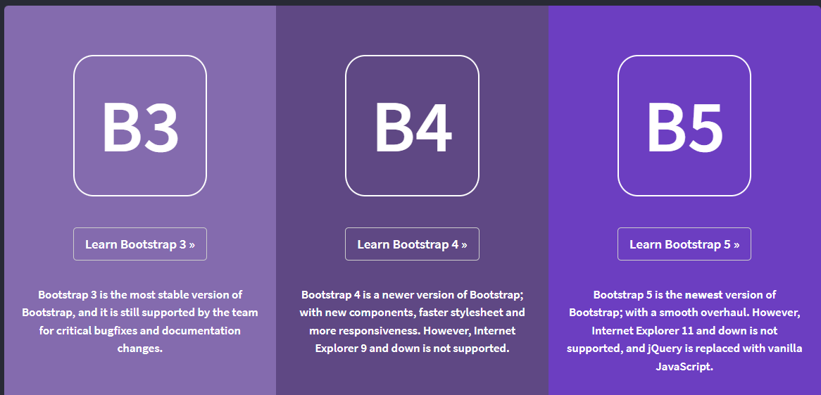

Slide 10
Bootstrap 5 vs. Bootstrap 3 & 4
Bootstrap 5 is the newest version of Bootstrap; with new components, faster stylesheet and more responsiveness.
Bootstrap 5 supports the latest, stable releases of all major browsers and platforms. However, Internet Explorer 11 and down is not supported.
The main differences between Bootstrap 5 and Bootstrap 3 & 4, is that Bootstrap 5 has switched to JavaScript instead of jQuery.

Slide 11
Downloading Bootstrap 5
If you want to download and host Bootstrap 5 yourself, go to https://getbootstrap.com/, and follow the instructions there.

Slide 12

Bootstrap 5 Containers
Containers are used to pad the content inside of them, and there are two container classes available:
The .container class provides a responsive fixed width container
The .container-fluid class provides a full width container, spanning the entire width of the viewport

Slide 13
Fixed Container
Use the .container class to create a responsive, fixed-width container.
Fluid Container
Use the .container-fluid class to create a full width container, that will always span the entire width of the screen (width is always 100%):

Slide 14
Container Padding
By default, containers have left and right padding, with no top or bottom padding. Therefore, we often use spacing utilities, such as extra padding and margins to make them look even better. For example, .pt-5 means "add a large top padding":
<div class="container pt-5"></div>

Slide 15
Container Border and Color
Other utilities, such as borders and colors, are also often used together with containers:
<div class="container p-5 my-5 border"></div> <div class="container p-5 my-5 bg-dark text-white"></div> <div class="container p-5 my-5 bg-primary text-white"></div>

Slide 16
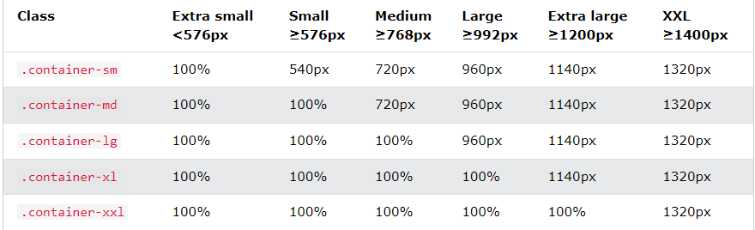
Responsive Containers
You can also use the .container-sm|md|lg|xl classes to determine when the container should be responsive.
The max-width of the container will change on different screen sizes/viewports:

Slide 17
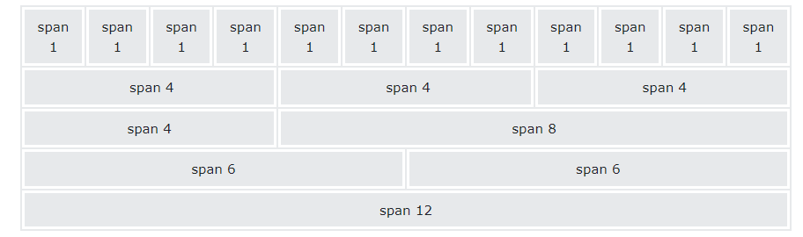
Bootstrap 5 Grid System
Bootstrap's grid system is built with flexbox and allows up to 12 columns across the page.
If you do not want to use all 12 columns individually, you can group the columns together to create wider columns

Slide 18
The grid system is responsive, and the columns will re-arrange automatically depending on the screen size.
Make sure that the sum adds up to 12 or fewer (it is not required that you use all 12 available columns).

Slide 19
Grid Classes
The Bootstrap 5 grid system has six classes:
.col- (extra small devices - screen width less than 576px)
.col-sm- (small devices - screen width equal to or greater than 576px)
.col-md- (medium devices - screen width equal to or greater than 768px)
.col-lg- (large devices - screen width equal to or greater than 992px)
.col-xl- (xlarge devices - screen width equal to or greater than 1200px)
.col-xxl- (xxlarge devices - screen width equal to or greater than 1400px)
The classes above can be combined to create more dynamic and flexible layouts.

Slide 20
Basic Structure of a Bootstrap 5 Grid
<!-- Control the column width, and how they should appear on different devices -->
<div class="row">
<div class="col-*-*"></div>
<div class="col-*-*"></div>
</div>
<div class="row">
<div class="col-*-*"></div>
<div class="col-*-*"></div>
<div class="col-*-*"></div>
</div>
<!-- Or let Bootstrap automatically handle the layout --> <div class="row"> <div class="col"></div> <div class="col"></div> <div class="col"></div> </div>

Slide 21
Bootstrap 5 Default Settings
Bootstrap 5 uses a default font-size of 1rem (16px by default), and its line-height is 1.5.
In addition, all <p> elements have margin-top: 0 and margin-bottom: 1rem (16px by default).

Slide 22
Bootstrap 5 Colors
Text Colors
Bootstrap 5 has some contextual classes that can be used to provide "meaning through colors".
The classes for text colors are: .text-muted, .text-primary, .text-success, .text-info, .text-warning, .text-danger, .text-secondary, .text-white, .text-dark, .text-body (default body color/often black) and .text-light
You can also add 50% opacity for black or white text with the .text-black-50 or .text-white-50 classes
Background Colors
The classes for background colors are:
.bg-primary,
.bg-success,
.bg-info,
.bg-warning,
.bg-danger,
.bg-secondary,
.bg-dark and
.bg-light.

